Slide 1
Team 5 – Rotor Blade Structures
Week No - 10
Date - 02.12.2025
Supervisor - Dr. Laurence Alhrshy
Presented by – Dongsuk Kim (770143)
Team Members - Bhima B Masare, Anudeep Allanki, Dongsuk Kim, Mithun Shetty

Slide 2
Contents
1. Rotor Blade Structures Team Time line
2. Tasks planned for Project
3. Spar Cap -
  3.1 About Spar Caps
      3.1.1 Types of Spar Caps
      3.1.2 Types of Bending Moments on Spar Caps
      3.1.3 Bending Stiffness & Stresses of Spar Caps
      3.1.4 Blade Design using NuMAD
      3.1.5 Developing the Blade of WEC 2025 Optimus Syria in NuMAD (Test 2)
      4. Material Selection for 77.75 m Blade
Bibliography
Dongsuk Kim

Slide 3
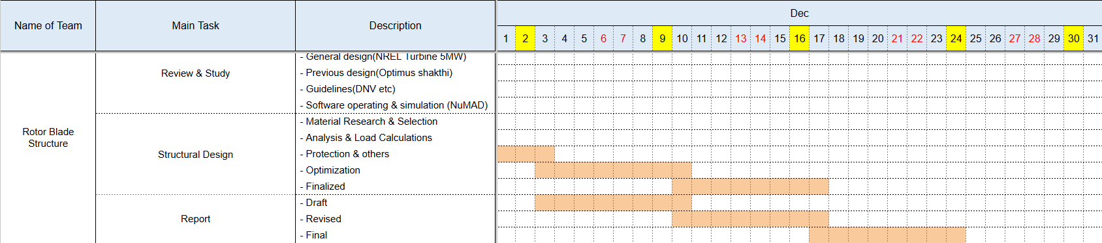
1. Rotor Blade Structures Team Time line -
1.1 Team Time line for Month November -
Dongsuk Kim

Slide 4
2. Tasks planned for Project –
Material Selection
Spar Cap & Shear Web Thickness
Develop Blade Model in NuMAD
Analysis with Precomp
Iterate and refine the design
Dongsuk Kim

Slide 5
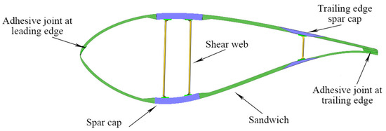
3. Spar Caps –
3.1 About Spar Caps -
The main structural component (backbone) of a wind turbine blade.
They are long, thick beams that run along the length of the blade.
Located on the top (suction side) and bottom (pressure side) of the blade's main spar, or internal box beam.
Their primary job is to give the blade its stiffness and strength.
Figure 1 – Blade Structures
Source - Impact of Process Technology on Properties of Large-Scale Wind Turbine Blade Composite Spar Cap by Yuanrong Sun, Congli Hu, Jianbo Li
Dongsuk Kim

Slide 6
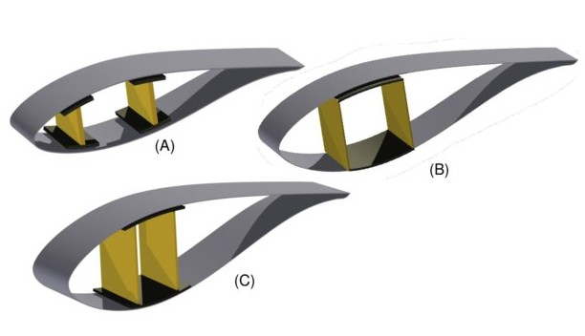
3. Spar Caps –
3.1.1 Types of Spar Caps –
a. Box Spar Design –
  It is the most common and conventional design.
  These two caps are connected by one or more vertical shear webs, forming a strong, hollow "box beam" that runs down the length of the blade.
Figure 2 – Box Spar Caps,
A: three cell with shear webs & spar caps,
B: three cell box type, with single inter-web capping,
C: three cell, with single capping extending fore and aft of the shear webs.
Source - Multi-disciplinary constraint optimization of wind turbines by Carlo Luigi Bottasso, Filippo Campagnolo, Alessandro Croce
Dongsuk Kim

Slide 7
3. Spar Caps –
3.1.2 Bending Stress Analysis on Spar Caps –
  a. Input Tables – (from WEC Shakthi 2024)
    loads.csv: spanwise position & flapwise bending moments
    thickness.csv: blade thickness (distance between spar caps)
  b. Material Properties –
    Glass Fiber: E = 43 GPa, σ_max = 750 MPa, ρ = 1930 kg/m³, SF = 1.6
Dongsuk Kim

Slide 8
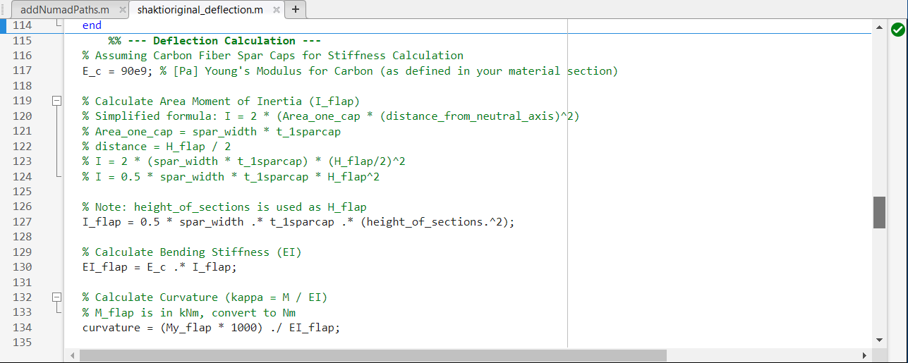
3. Spar Caps –
3.1.3 Bending Stiffness & Stress Analysis on Spar Caps – (updated code)
  c. MatLab Code for Maximum Stress (σmax) & Minimum Stress (σmin)
  d. MatLab Code for Bending Stiffness (EI) for Flapwise & Edgewise Bending
Dongsuk Kim

Slide 9
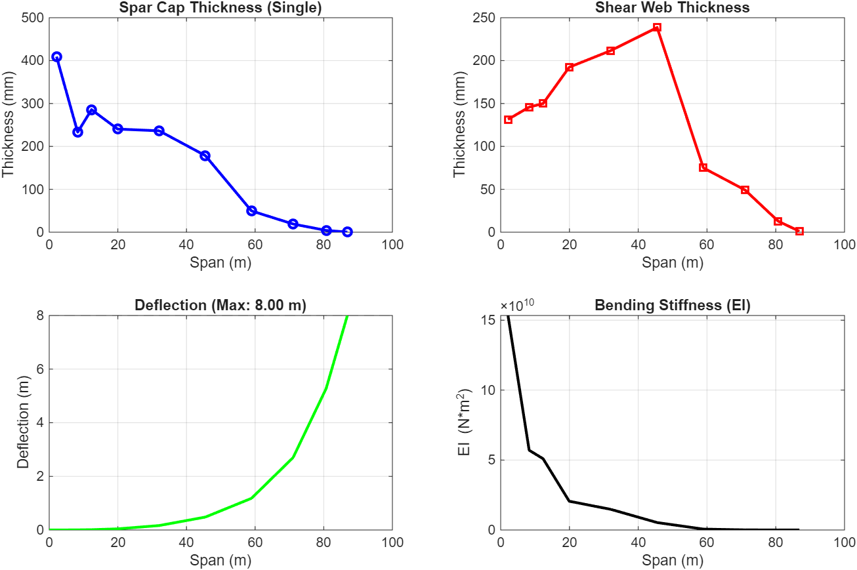
3. Spar Caps –
3.1.3 Bending Stiffness & Stress Analysis on Spar Caps –
  e. Plots from MatLab for Analysis with Deflection Limit (8 m) –
Dongsuk Kim

Slide 10
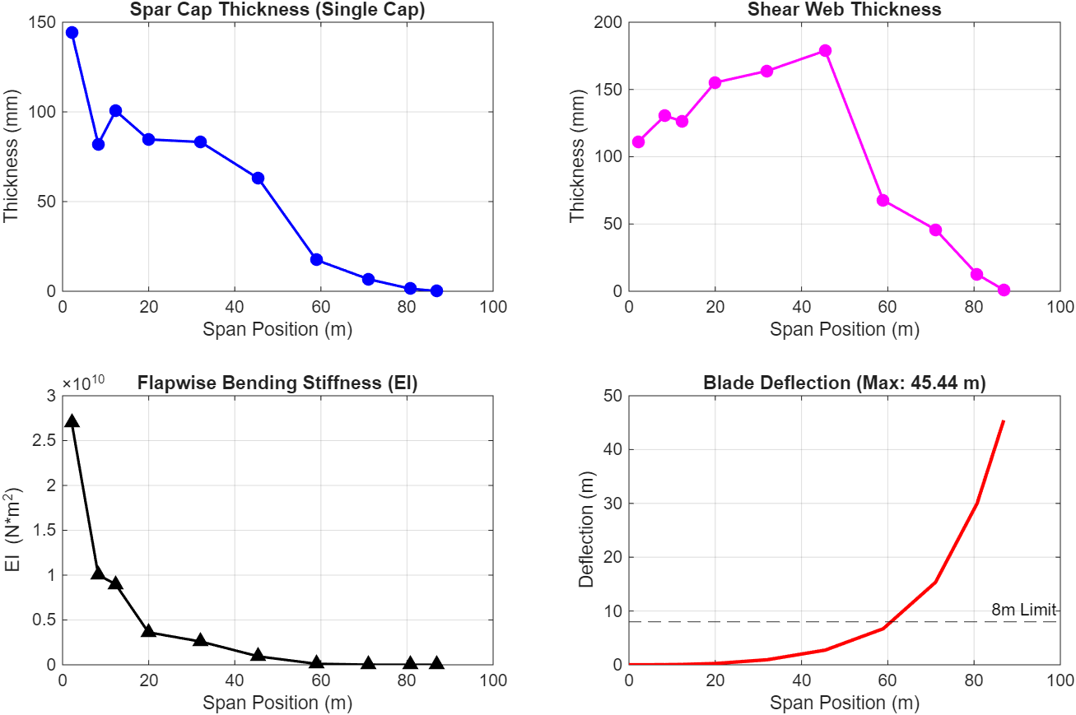
3. Spar Caps –
3.1.3 Bending Stiffness & Stress Analysis on Spar Caps –
  f. Plots from MatLab for Analysis with No Deflection Limit (8 m) –
Dongsuk Kim

Slide 11
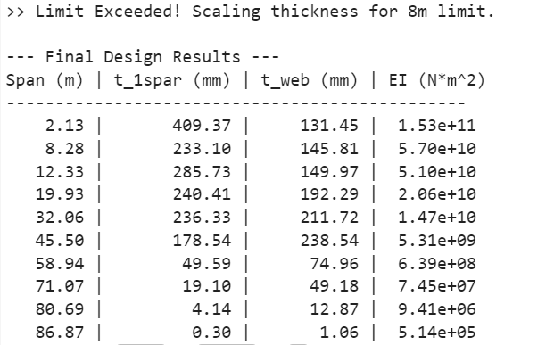
3. Spar Caps –
3.1.3 Bending Stiffness & Stress Analysis on Spar Caps –
  g. Table from MatLab for Analysis with Deflection Limit (8 m) –
Dongsuk Kim

Slide 12
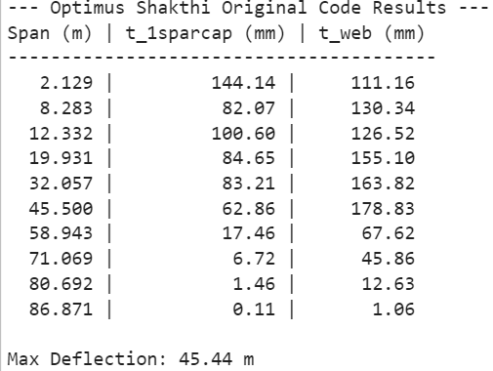
3. Spar Caps –
3.1.3 Bending Stiffness & Stress Analysis on Spar Caps –
  h. Table from MatLab for Analysis with No Deflection Limit (8 m) –
Dongsuk Kim

Slide 13
3. Spar Caps –
3.1.4 Blade Design using NuMAD –
a. NuMAD (Numerical Manufacturing And Design) –
The following are the steps to model a Blade using NuMAD –
  Step 1 – Geometry Definition
  Step 2 – Material & Composite Definition
  Step 3 – Internal Structural Layout
  Step 4 – Mesh Generation & FEA Export
Dongsuk Kim

Slide 14
3. Spar Caps –
3.1.5 Developing the Blade of WEC 2025 Optimus Syria in NuMAD – (Test 2)
a. Airfoils – (Test 2)
Node | 01 | – | Circular Airfoil (D = 4.2 m)
Node | 02 | – | Circular Airfoil (D = 4.2 m)
Node | 03 | – | Circular Airfoil (D = 4.2 m)
Node | 04 | – | Circular Airfoil (D = 4.2 m)
Node | 05 | – | D60_V5
Node | 06 | – | D60_V5
Node | 07 | – | DU408B
Node | 08 | – | DU408B
Node | 09 | – | DU408B
Node | 10 | – | DU35_A17
Node | 11 | – | DU35_A17
Node | 12 | – | DU30_A17
Node | 13 | – | DU30_A17
Node | 14 | – | DU30_A17
Node | 15 | – | DU25_A17
Node | 16 | – | DU25_A17
Node | 17 | – | DU21_A17
Node | 18 | – | DU21_A17
Node | 19 | – | NACA 63(3)-618
Node | 20 | – | NACA 63(3)-618
Dongsuk Kim

Slide 15
3. Spar Caps –
3.1.5 Developing the Blade of WEC 2025 Optimus Syria in NuMAD –
b. Blade Geometry Details – (Test 2)
Nodes | Pos [m] | Chord [m] | Twist [deg] | Airfoil
01 | 0 | 4.2 | 18 | Circular_Foil
02 | 2.129 | 4.2 | 18 | Circular_Foil
03 | 4.258 | 4.2 | 18 | Circular_Foil
04 | 6.283 | 4.2 | 18 | Circular_Foil
05 | 8.308 | 4.2 | 18 | D60B_V5
06 | 10.332 | 4.2 | 17.03 | D60B_V5
07 | 12.357 | 4.2 | 16.07 | DU40B
08 | 17.931 | 4.2 | 10.89 | DU40B
09 | 20.718 | 4.2 | 8.31 | DU40B
10 | 23.505 | 4.2 | 5.72 | DU35_A17
Nodes | Pos [m] | Chord [m] | Twist [deg] | Airfoil
11 | 30.057 | 3.663 | 3.47 | DU35_A17
12 | 36.61 | 3.126 | 1.23 | DU30_A17
13 | 40.055 | 2.953 | 0.92 | DU30_A17
14 | 43.5 | 2.78 | 0.62 | DU30_A17
15 | 50.39 | 2.434 | 0.02 | DU25_A17
16 | 56.943 | 2.1 | 0.66 | DU25_A17
17 | 63.495 | 1.8 | 1.3 | DU21_A17
18 | 69.059 | 1.5 | 0.49 | DU21_A17
19 | 74.643 | 1 | -0.33 | NACA 63_(3)-618
20 | 77.75 | 0.5 | 0 | NACA 63_(3)-618
Dongsuk Kim

Slide 16
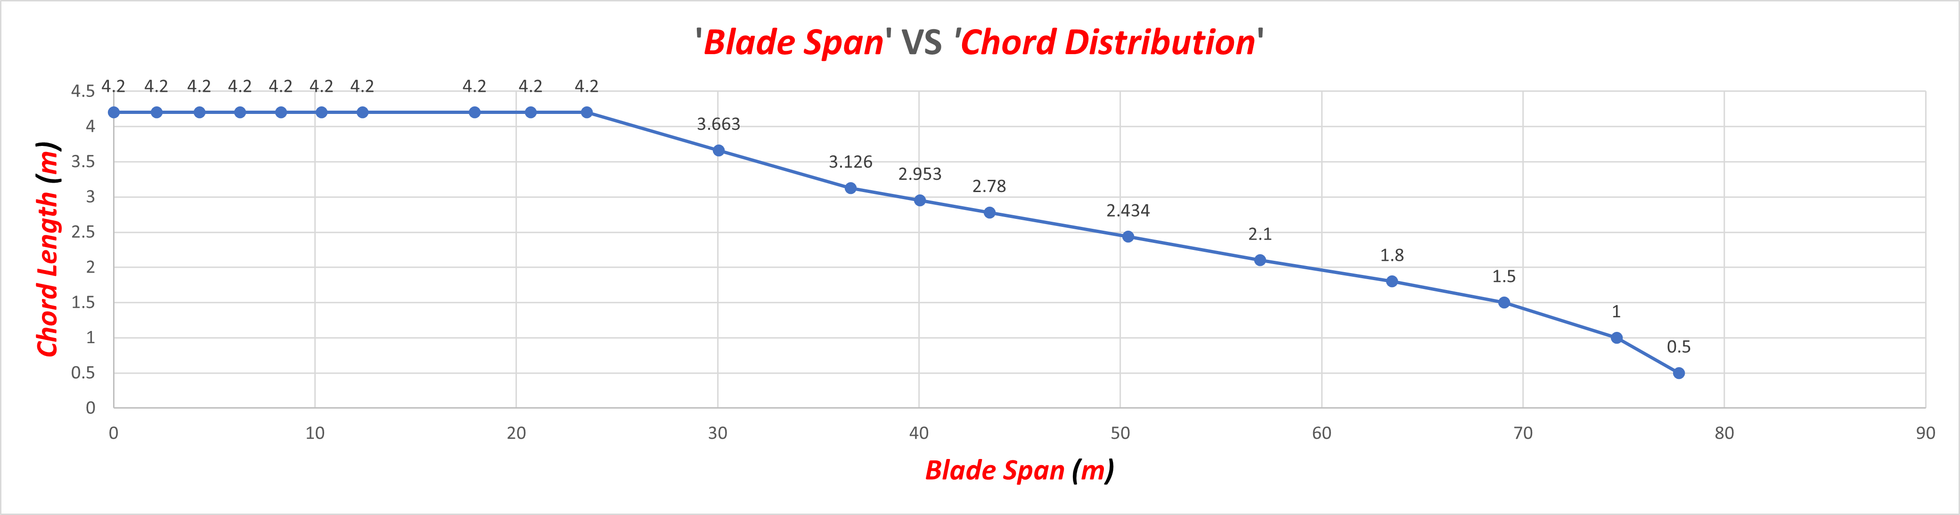
3. Spar Caps –
3.1.5 Developing the Blade of WEC 2025 Optimus Syria in NuMAD –
c. ‘Blade Span’ VS ‘Chord Distribution’ – (Test 2)
Bhima Babu Masare

Slide 17
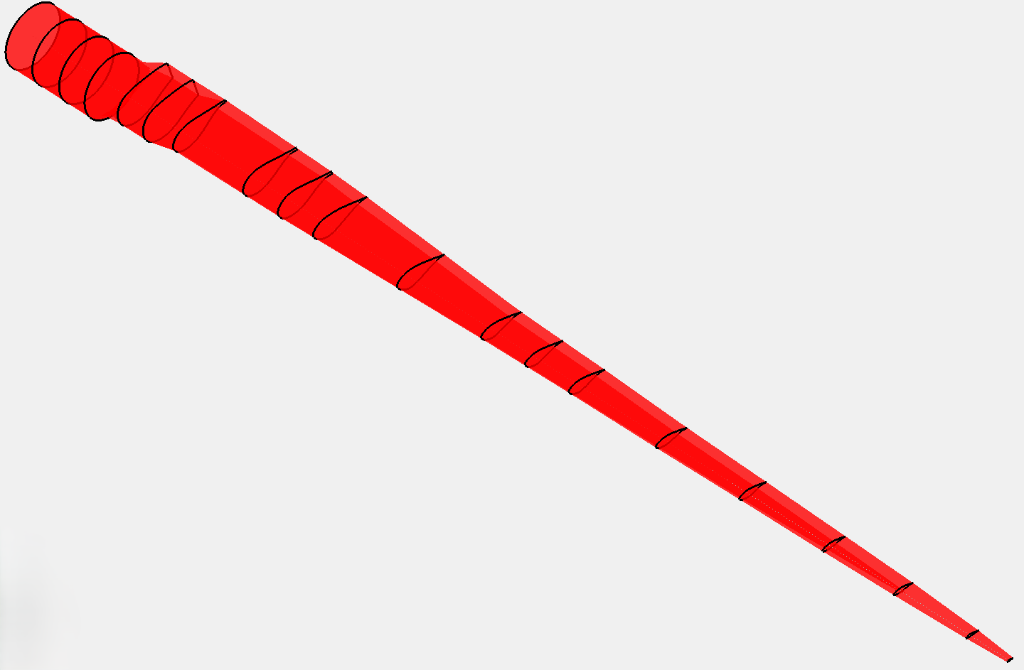
3. Spar Caps –
3.1.5 Developing the Blade of WEC 2025 Optimus Syria in NuMAD –
d. Blade Model in NuMAD – (Test 2)
Figure 4 – Blade Model in NuMAD
Note – This is not the final design some parameters needs to be modified later.
Dongsuk Kim

Slide 18
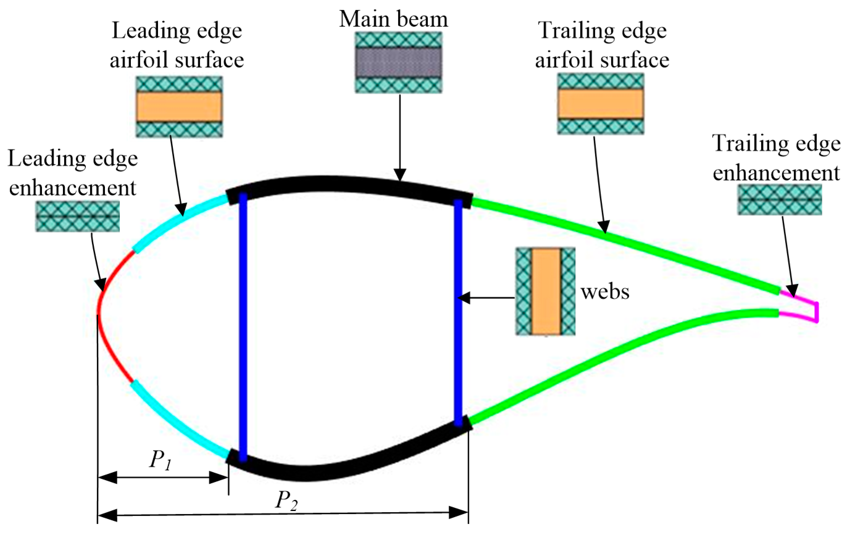
4. Material selection for 77.75m Blade–
4.1 Design limit and comparison –
Airfoil Structure | Blade Region | NREL 5 MW (61.50m) | Optimus 5NW (77.75m) | Reason
 | Spar Cap | Hybrid Carbon + Glass UD (0°) | Full Carbon UD (0°) | - Higher bending moment. - Increase EI and reduce tip deflection & mass.
 | Shell (Suction/Pressure) | Glass Triax (±45/0/90) Lay-up: [±45 / 0 / 90 / ±45 / 0]ₛ | Glass Triax (±45 dominant) Lay-up: [±45 / 0 / ±45 / 90 / ±45 / 0 / ±45]ₛ | - More ±45° plies increase torsional stiffness (GJ) - shear resistance for longer, flexible blades.
 | Shear Webs | Glass ±45 + thin foam core Lay-up: [±45/G] + Core + [±45/G] | Glass ±45 + thicker foam core (50 → 80 mm) Lay-up: [±45/G] + Core(↑t) + [±45/G] | - Shear load ↑ → thicker core improves shear stiffness & buckling resistance.
 | Core (in Shell) | PVC / Balsa Foam (ρ ≈ 60 kg/m³) | High-density PVC or PET Foam (ρ ≈ 80–100 kg/m³) Thickness tapered along span | - Prevent shear failure & skin buckling under higher spanwise loads.
 | Trailing Edge (TE) | Glass + thin foam core Lay-up: [±45 / 0]ₛ + core | Glass + thicker foam + reinforcement patch Lay-up: [±45 / 0 / ±45]ₛ + core | Local buckling risk ↑; reinforced TE prevents opening, improves fatigue resistance.
 | Leading Edge (LE) | Glass + solid insert | Glass + Carbon Hybrid (optional) | - Improve impact, erosion resistance in longer blades.
 | Root Region | Thick Glass + Adhesive Joint | Glass + Carbon Hybrid (optional) | - Increase root strength and reduce weight for bolt interface.
Suction side
Front shell
Spar cap
Rear shell
Front shear web
Rear shear web
Third shear web
Front shell
Rear shell
Spar cap
Pressure side
Source https://www.researchgate.net/figure/Blade-parts-and-positions_fig2_345335704
Dongsuk Kim

Slide 19
4. Material selection for 77.75m Blade –
4.2 Cost Caculation Method
1
2
3
Geometry
(Aero Team)
Geometric integration
(Structure Team)
Cost Calculation
(Structure Team)
Revison2
Revison1
Revison2
▪ Pos(m)
▪ Chord(m)
▪ Twist(deg)
▪ Foil
▪ Polar
▪ Shell area = (upper+lower)
▪ Web skin = area Shear web height
× span integration
▪ Spar cap width = 15% chord
(both caps combined)
▪ LE/TE reinforcement = 5%×shell
area each
▪ Core area = portion of shell/web
with thickness
▪ Glass: €1.8/kg
▪ Carbon: €25/kg
▪ Core: €4/kg
▪ Resin: €4/kg
▪ Adhesive: €10/kg
T/C (Assume)
Material Usage (Estimation)
Total cost
▪ DU40 40%
▪ DU35 35%
▪ DU25 25%
▪ NACA 63(3)- 618 18%
▪ Circular root 100%
▪ Shell :18kg/㎡
▪ Web : 15kg/㎡
▪ Spar caps : 25kg/㎡(UD Carbon)
▪ Core materials : ρ=90 kg/m³
▪ LE/TE reinforcement: 20 kg/m²
▪ Materials: 55%
▪ Manufacturing: 35%
▪ Quality & Process: 10%
Dongsuk Kim

Slide 20
4. Material selection for 77.75m Blade –
4.2 Main Blade Materials and Cost –
Material | Mass_NREL (kg) | Cost_NREL (€) | Mass_Optimus (kg) | Cost_Optimus (€) | Δmass (kg) | Mass_ratio （Opt/NREL） | Δcost (€) | Cost_ratio （Opt/NREL）
E-glass fiber | 13,000 | 23,400 | 15,480 | 27,864 | 2,480 | 119% | 4,464 | 119%
Carbon fiber | 500 | 12,500 | 928 | 23,210 | 428 | 186% | 10,710 | 186%
Core (PET/PVC/Balsa) | 1,200 | 4,800 | 1,795 | 7,180 | 595 | 150% | 2,380 | 150%
Epoxy resin | 5,000 | 20,000 | 6,071 | 24,285 | 1,071 | 121% | 4,285 | 121%
Adhesive & gel coat | 100 | 1,000 | 160 | 1,600 | 60 | 160% | 600 | 160%
MATERIALS(35%) | 19,800 | 61,700 | 24,435 | 84,139 | 4,635 | 123% | 22,439 | 136%
Manufacturing (35%) |  | ≈ 39,200 |  | ≈ 53,543 |  |  | 14,343 | 136%
Quality & Process (10%) |  | ≈ 11,200 |  | ≈ 15,298 |  |  | 4,098 | 136%
TOTAL (100%) |  | ≈ 112,000 / blade |  | 152,981 / blade |  |  | 40,981 | 136%
Dongsuk Kim

Slide 21
Bibliography
Definition of a 5 MW/61.5m Wind Turbine Blade Reference Model by Brian R. Resor, Sandia National Laboratories, California, USA
Definition of a 5 MW Reference Wind Turbine for Offshore System Development, J. Jonkman, S. Butterfield, W. Musial, and G. Scott, National Renewable Energy Laboratory, USA
Reports from Optimus Shakthi 2024
Lecture Scripts from Prof. Dr. Francesco Previtali
Lecture Scripts from Prof. Dr. Laurence Alhrshy
Impact of Process Technology on Properties of Large-Scale Wind Turbine Blade Composite Spar Cap by Yuanrong Sun, Congli Hu, Jianbo Li
Multi-disciplinary constraint optimization of wind turbines by Carlo Luigi Bottasso, Filippo Campagnolo, Alessandro Croce
A concept study of a carbon spar cap design for a 80m wind turbine blade by Malo Rosemeier, M Bätge
Design & Analysis of Equipment for Load Introduction during Full Scale Blade Test by J. Andersen, M. Escudero, L. Larsen, J. Thuesen, A. Vissamsetty
Bhima Babu Masare

